Slide 1
Asset Uploading README
Consult this before uploading assets to the Virgo project file
I’ll be demonstrating the process with a downscaled version of the game logo, which we can use for the project thumbnail.

Slide 2
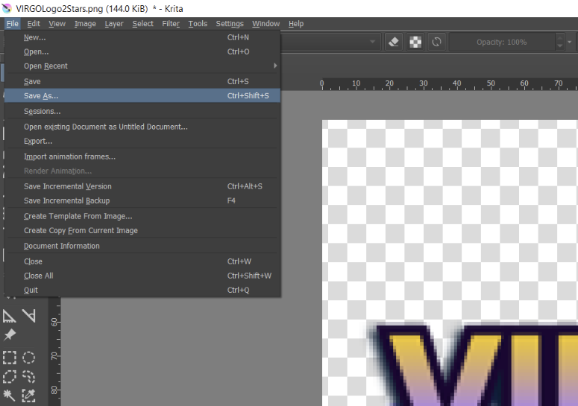
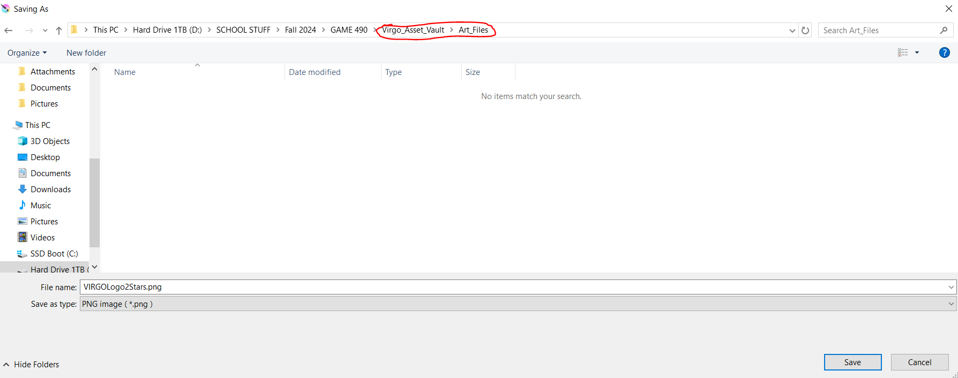
Saving
When creating an asset, upload it to “Virgo Asset Vault” and the relevant folder (we have an art assets folder and a sound assets folder at present, but feel free to add what you need).
Do not upload it directly to the project folder!

Slide 3
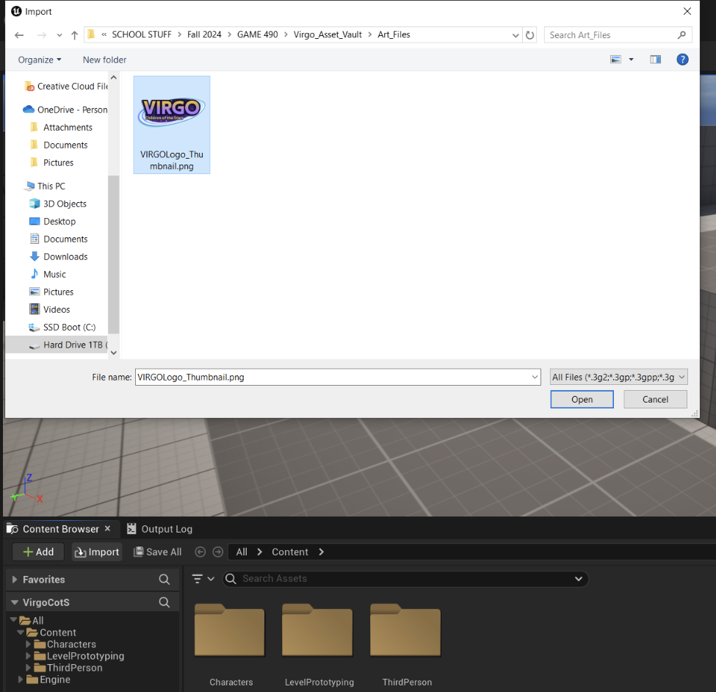
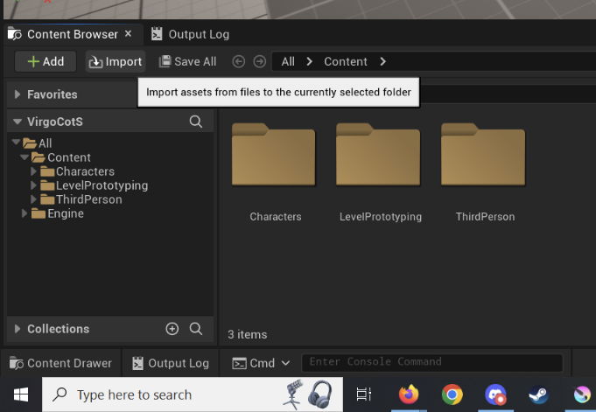
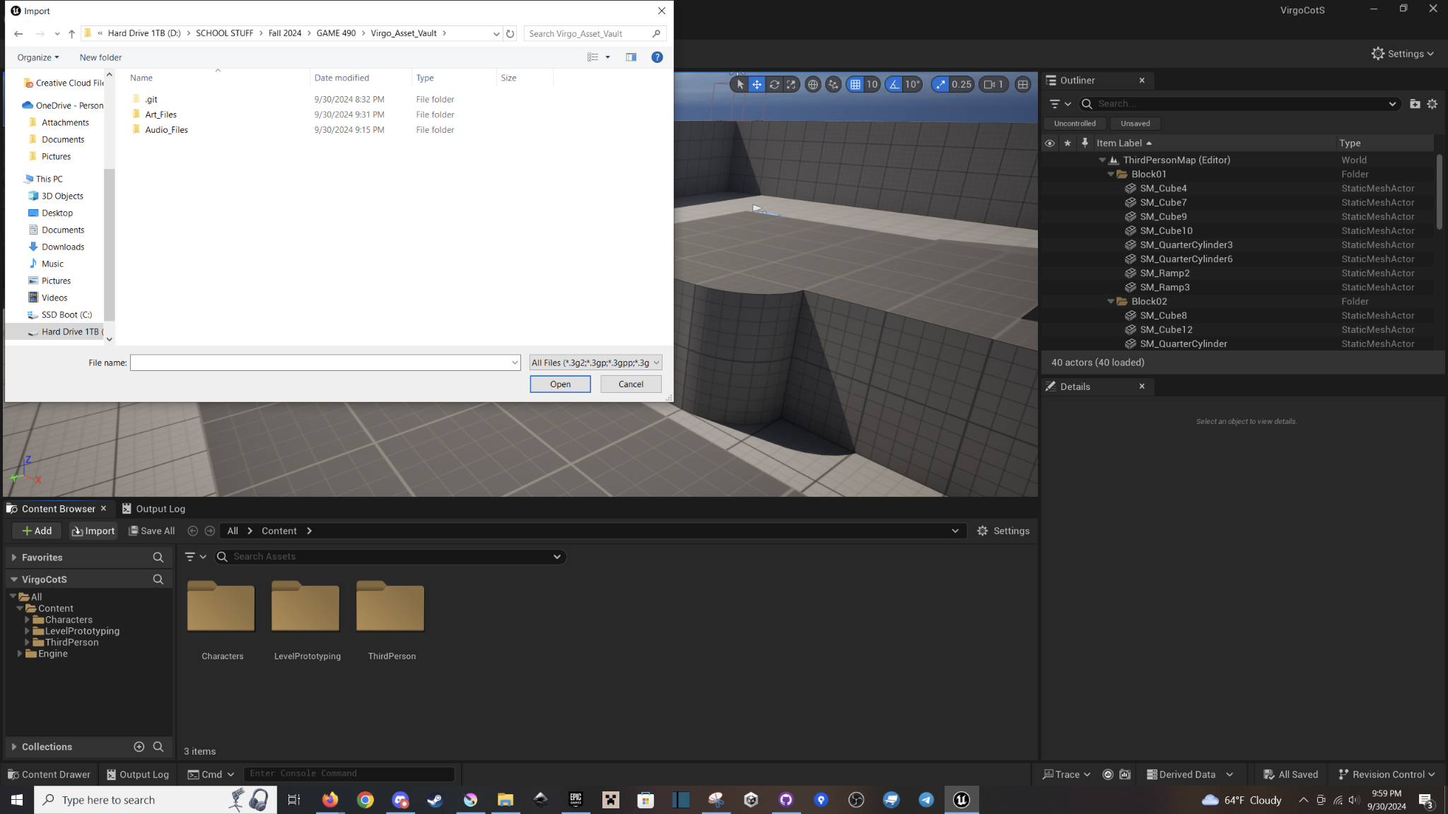
2. Uploading
In Unreal, click “Import” and navigate to the Asset Vault Repo. Then click “Open.” PULL BEFORE DOING SO!
Notes:
We can work on organizing things once we get more assets in the project.

Slide 4
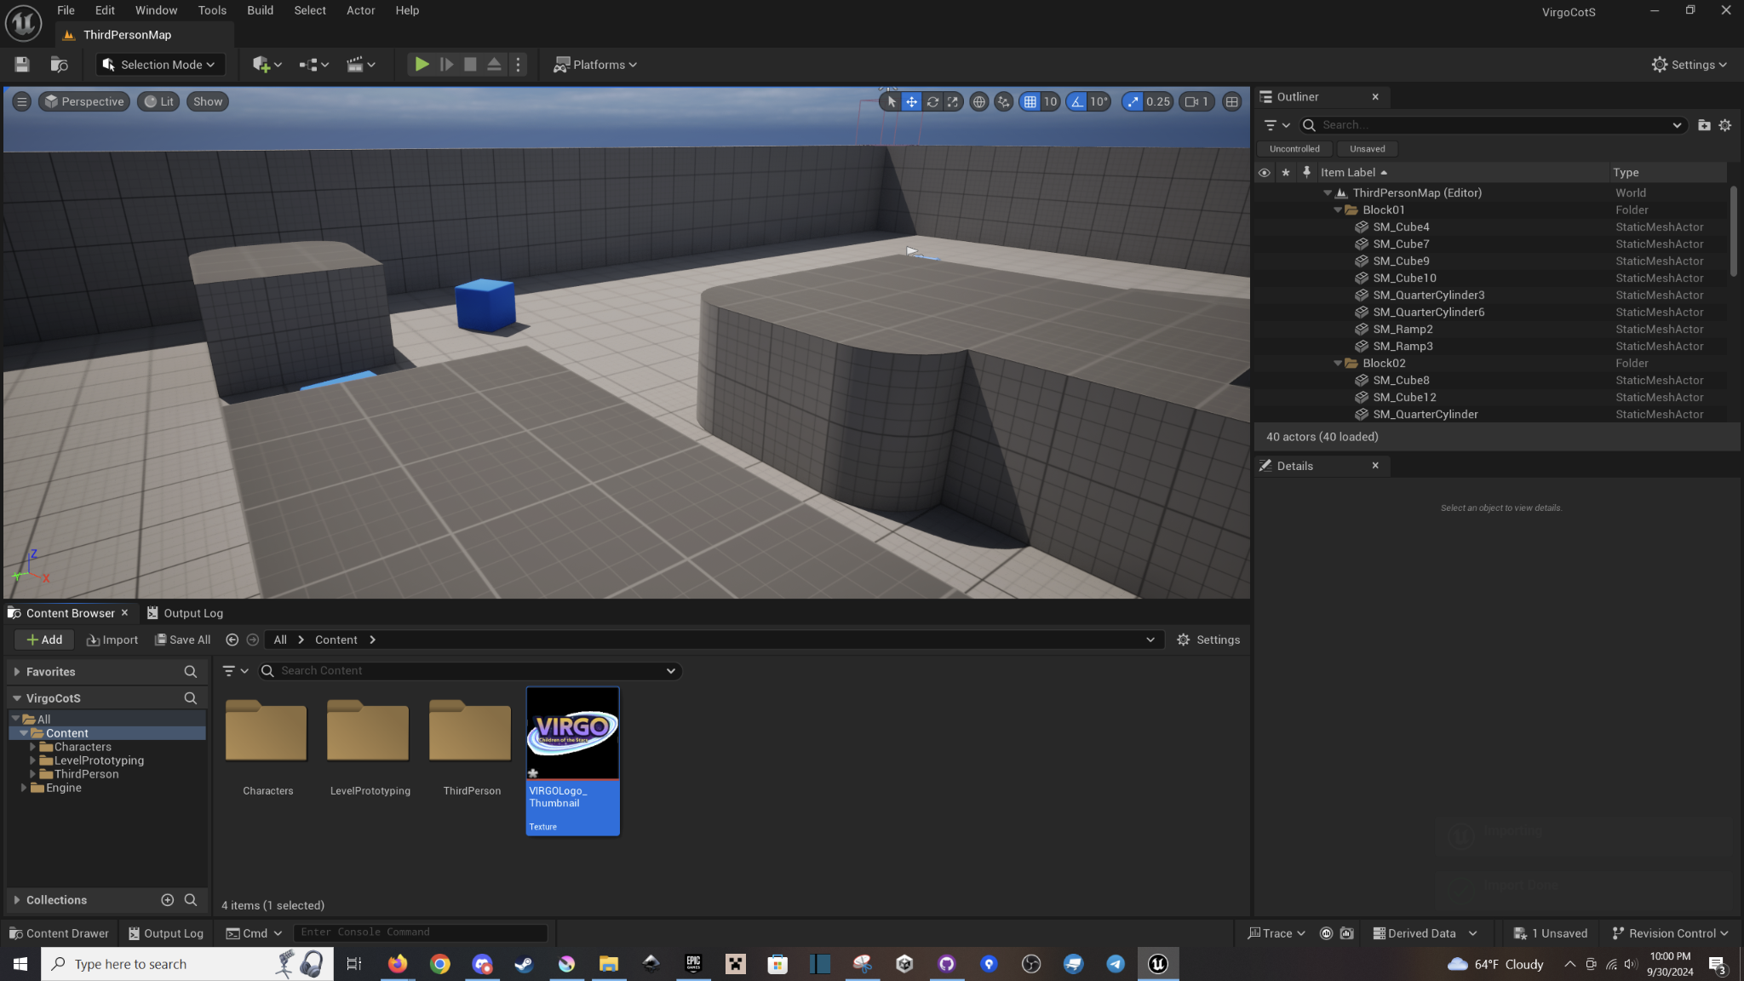
And you’re done! Make sure you push!

